Slide 1

New Sampling Scheme
Determination of minimum sampling size
Luis Rodriguez Lado - GSP

Slide 2
Agenda
Generate random samples at growing sample sizes by fixed intervals and several iterations
Calculate KL-divergence metrics
Optimization of sample size using KL-divergence
Fit exponential decay function of KL-divergence
Calculate CDF of (1 - KL-div)
Determine minimum sample size upon (1- KL-div) at a certain cut-off threshold
Case study
Acknowledgements
References

Slide 3
Spatial representativeness of samples
How well soil samples capture the true spatial variation and characteristics of soils in the area?
Soils properties are related to the environmental characteristics, defined as raster layers.
Characterize the environmental variability in the area.
Identify the environmental variability at random sampling points.
Compare the probability distribution of the population (P) and the probability distribution of the samples (Q) variabilities through similarity metrics (Kullback–Leibler divergence)
Determine in which extent P can be explained by Q.
Evaluate the degree in which the dataset represents the study area.

Slide 4
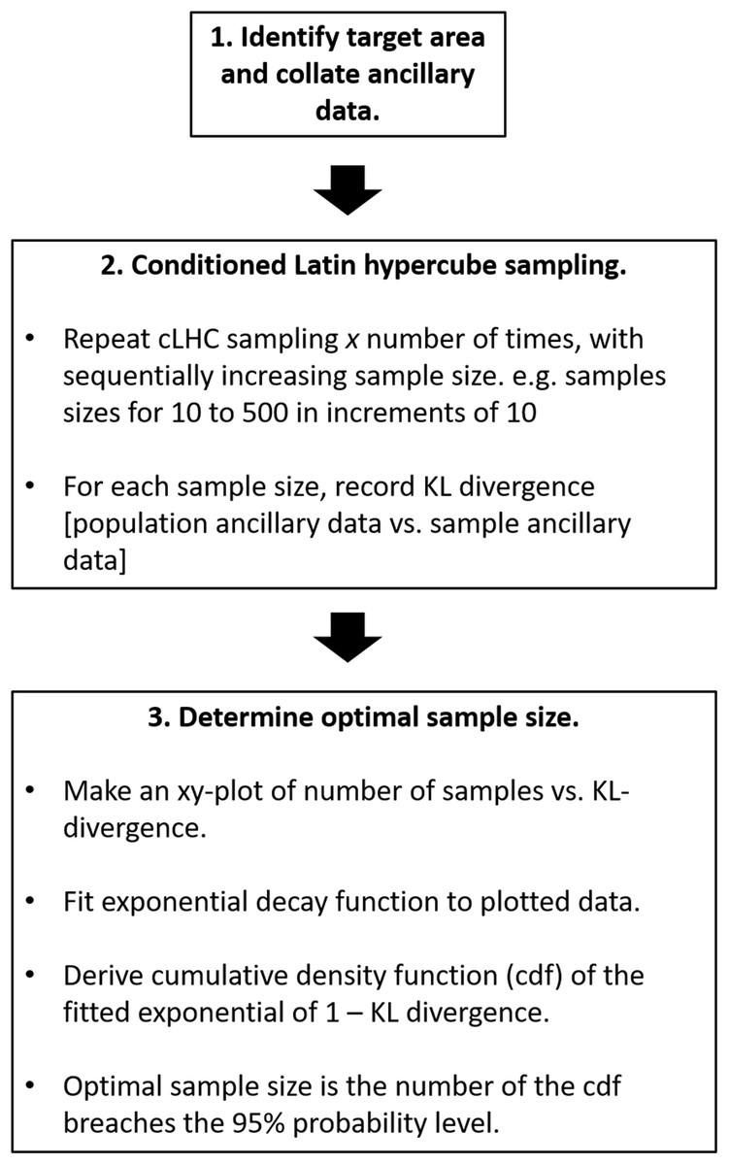
Sample number size optimization algorithm
Malone et al, 2019
KL-divergence
"KL divergence" is a way to measure how different two probability distributions are from each other.
Compares probability distributions of population (P) vs samples (Q).
P represents the "true" or "real" distribution of environmental variability
Q represents an “approximation” of P using a sample set.
KL divergence indicates how much information is lost when using Q to approximate P.
If P and Q are exactly the same, KL divergence = 0, samples capture all the information in the area.
Generally P and Q are different, KL divergence > 0, there's a difference between the two distributions.
The smaller the KL divergence, the closer Q is to P, and the better the approximation.
The larger the KL divergence, the more Q differs from P.
KL(Q||P) = Σ(Q(x) * log(Q(x) / P(x)))
Σ represents the sum over all possible values of x.
Q(x) is the probability (or density) of x in distribution Q.
P(x) is the probability (or density) of x in distribution P.

Slide 5
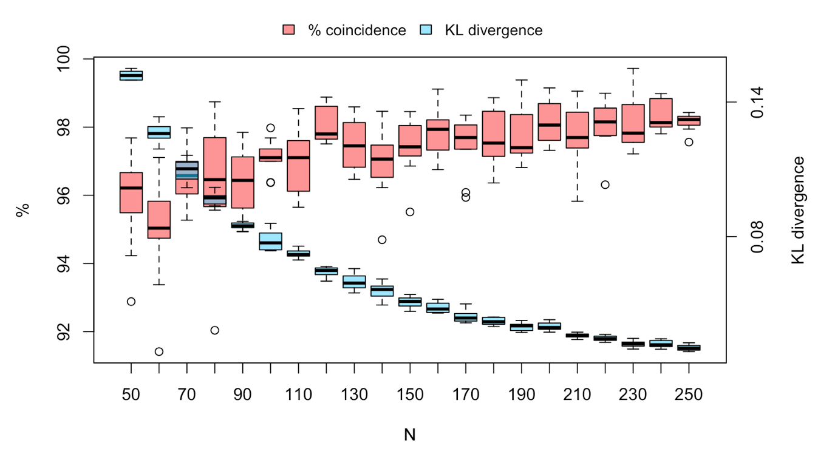
Determine minimum sample size
Dispersion in KL and % representativeness in the iteration trials for each sample size

Slide 6
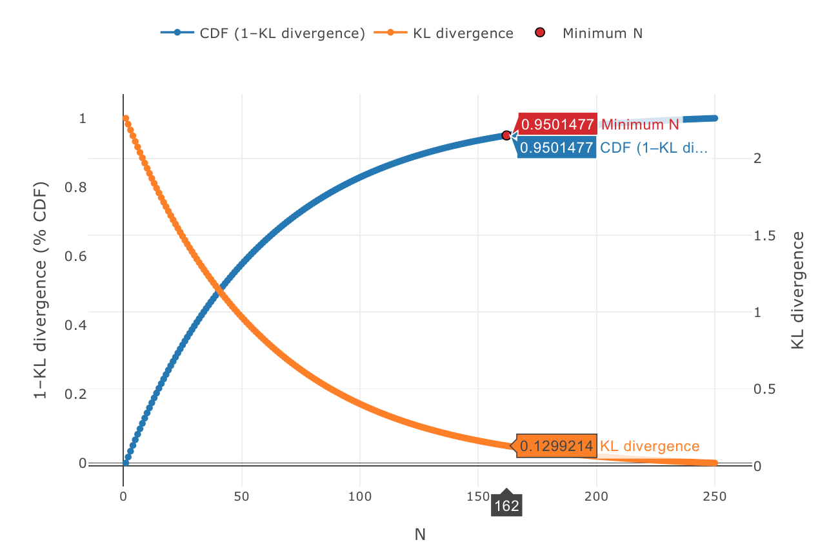
Determine minimum sample size
Predicted KL-div decay and CDF (1-KL-div)
cut-off = 0.95

Slide 7
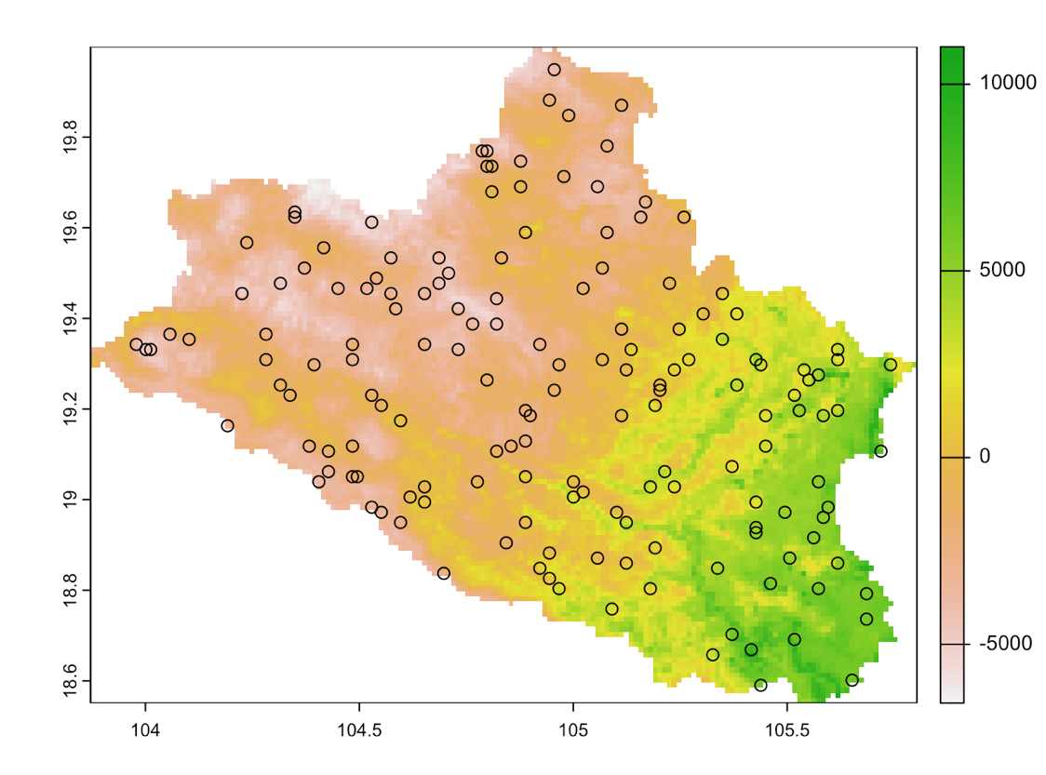
Determine minimum sample size
Distribution of samples in the optimal iteration from the selected
minimum sample size
N = 162

Slide 8
Factors affecting sampling size calculations
Raster covariates:
Number of covariates: Higher amounts of environmental layers increase the environmental diversity and thus also Min_N
Resolution: Higher resolution is (often) linked to higher variability. Min-N is expected to be higher.
Number of iterations: Better results are achieved with a higher number of iterations for each sample size.
Quantile size: Higher quantile bins mean higher variability in the data input. The minimum sample size increases with the number of bins

Slide 9
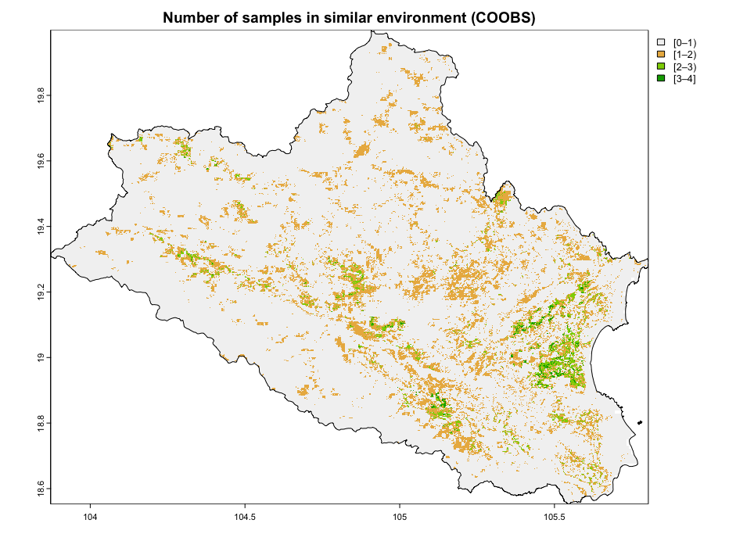
Evaluation of results by COOBS
COOBS :
Count of observations (COOBS) is an algorithm to map relatively adequate and under-sampled areas on a sampling pattern.
It allow one to understand which areas in a spatial domain are adequately and under-sampled.
COOBS ca be used to design an additional survey by limiting the cLHS algorithm to areas where the COOBS value is below some specified threshold.

Slide 10
Conclusion and Q&A
KL-divergence can be used to determine the point at which the sample size fulfills a certain threshold of similarity with the environmental characteristics that can be used to describe the environment in the area.
The calculation of Min-N is highly dependent on input model parameters.
COOBS mapping is recommended to determine areas with low representativity in the sampling scheme.

Slide 11
Additional exercises
Calculate minimum and and optimal sample size with opendsm
Considers different combinations of sample sizes, iterations and bin sizes.

Slide 12
Case study
Contents in the exercise:
Data Preparation (terra)
Determination of the minimum sampling size with KL-div
Evaluation of results by COOBS

Slide 13
Acknowledgments
We want to acknowledge the following authors for the distribution of the R scripts/data included partially in this manual.
@Malone et al
@Saurette et al
Vietnam

Slide 14
References
Goodbody, T.R., Coops, N.C. & Queinnec, M. 2023. Structurally guided sampling. (also available at https://cran.r-project.org/package=sgsR).
Roudier, P., Brugnard, C., Beaudette, D., Louis, B., Daust, K. & Clifford, D. 2011. Clhs: A r package for conditioned latin hypercube sampling. (also available at https://cran.r-project.org/web/packages/clhs/).
Malone, B.P., Minansy, B. & Brungard, C. 2019. Some methods to improve the utility of conditioned latin hypercube sampling. PeerJ, 7: e6451. https://doi.org/10.7717/peerj.6451
Saurette, D. , Biswas, A., Heck, R.J., Gillespie, A.W., Berg, A.A. 2022. Determining minimum sample size for the conditioned Latin hypercube sampling algorithm, Pedosphere.
Saurette, D. , Heck, R.J., Gillespie, A.W., Berg, A.A., Biswas, A. 2022. Divergence metrics for determining optimal training sample size in digital soil mapping, Geoderma, 436.

Slide 15
Index of the script
0 - Set working directory and load necessary packages
1 - User-defined variables
2 - Import national data
3 - Calculate the minimum sample size to describe the area
4 - Plot covariate diversity as PCA scores
5 - KL divergence and % similarity results for growing N samples
6 - Model KL divergence
7 - Determine the minimum sample size for 95% coincidence
8 - Determine the optimal iteration according to the minimum N size
9 - Plot minimum points from best iteration
10 - Calculate COOBS (sgsR)
11 - Calculate minimum and and optimal sample size with opendsm

Slide 16
Contact Information
luis.rodriguezlado@fao.org
marcos.angelini@fao.org

